Slide 1
DIET ANALYSIS 17mdc37(Bussiness statistics lab using r
SUBMITTED TO
Dr.S.Chandia,
Assistant Professor,
Coimbatore Institute of Technology.
DONE BY
Genga K
Mithraadharshini M K
Pooja M

Slide 2
PROBLEM STATEMENT
Diet is effective to loss weight by taking healthy food in regular intervals which in turn maintains the health of a body.
There are different diet types followed.
People are confused to choose which diet type is more effective.

Slide 3
OBJECTIVE
Here 3 diet types are taken for analysis
To analyse the weight loss in 3 diet types.
To provide a solution for the effective diet type
To analyse the results of diet types depending on gender to make the results more effective

Slide 4
DATASET USED
Data for three diet types are collected.
Dataset is collected from Kaagle.
It consists of 7 features and 76 records.
Dataset is analysed with various tools in R

Slide 5
PREVIOUSLY USED METHODS
1.Descriptive Statistics
2.One way anova
3.Two way anova
4.Kruskal Wallis rank sum test
5.Non parametric Test
6.Data Visualisation(Box plot)

Slide 6
UPDATED TECHNIQUES
Linear Regression and Scatter plot
Time series Analysis
Cumsum
Markov Chain Monte Carlo
Auto Regression
Auto Correlation

Slide 7

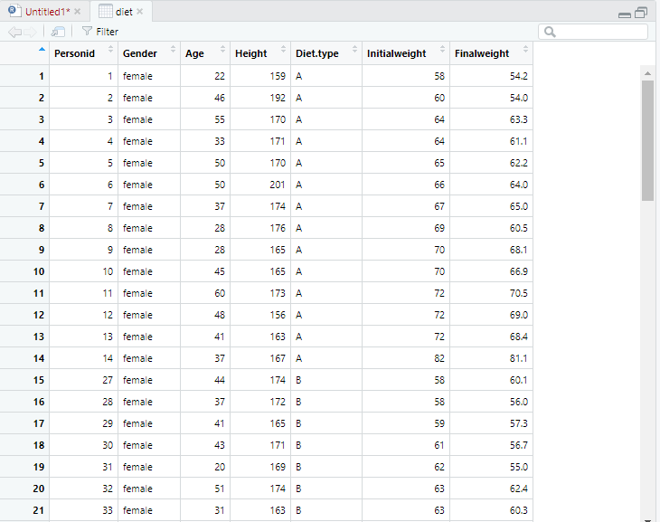
IMPORTING THE DATASET IN R

Slide 8
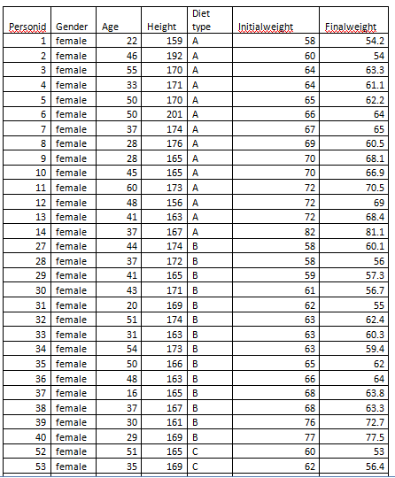
DATASET

Slide 9
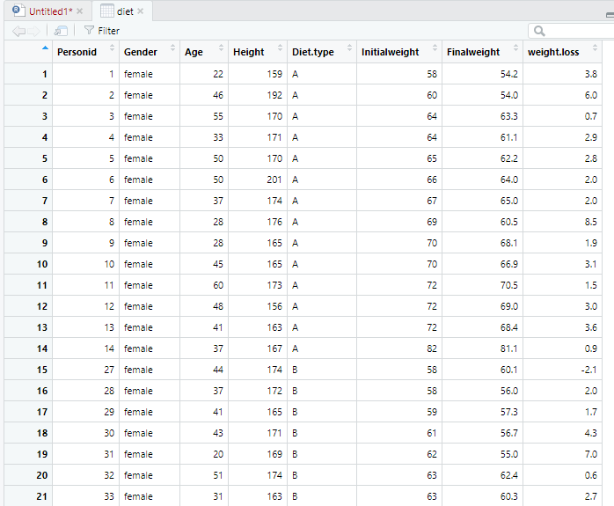
Calculating weight loss

Slide 10
Categorizing and store the data
factor()
Factors are used to represent the categorical data.
Factors can be ordered and are an important for statistical analysis and for plotting.
levels():
Factors can only contain pre-defined set values, known as levels
R always sort levels in ascending order.

Slide 11
factor()

Slide 12
Boxplot (weightloss vs diet type)
Boxplot are a measure of how well the data are distributed in a dataset.
This graph represents the minimum, maximum, median, first quartile, second quartile ,outliers in the dataset.

Slide 13
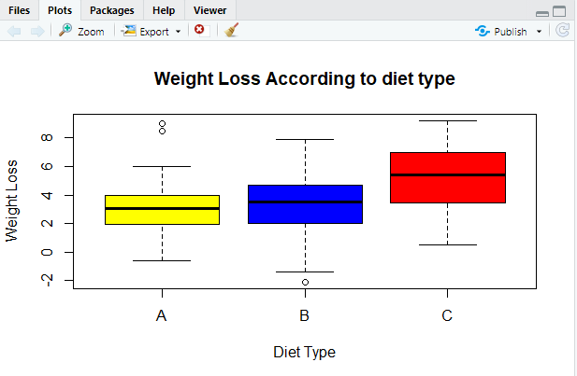
Data visualization
boxplot (diet$weight.loss~
diet$Diet.type,
ylab ="Weight Loss",
xlab="Diet Type",
col=c("yellow","blue","red"),
main="Weight Loss According to diet type")

Slide 14

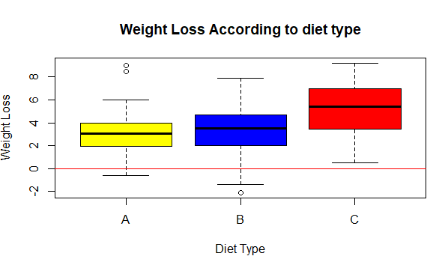
abline():
It is used to add a one or more straight lines to a graph.
It is used to add vertical ,horizontal or regression lines to plot.

Slide 15
Inference
From the boxplot, we can interpret the Diet ”C” has given a good result by loosing weight than other two Diets.

Slide 16
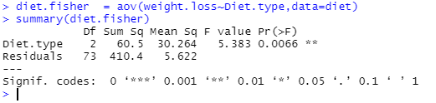
One way Anova
It is used to determine whether there is any significant difference between the average weight loss in 2 diet types.
Here p<0.05 then there exists the significant differences between the groups.

Slide 17
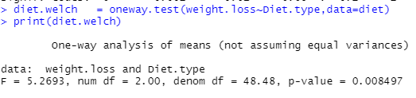
One way analysis of means
Test whether two or more samples from normal distributions have the same means.
The variances are not necessarily assumed to be equal.

Slide 18
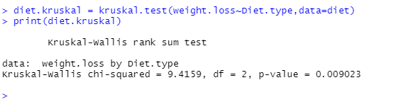
Kruskal-Wallis Rank Sum Test
It is used to determine if there are statistically significant differences between 2 or more groups of independent variable on a continuous dependent variable.
It is the nonparametric approach to one way anova.

Slide 19
Inference
Here the p value is less than the significance level 0.05, we can conclude that there are significant differences between the diet types.

Slide 20
Two sample t-test
The two sample T test also known as the independent sample T test is a method used to test whether the unknown population means of two groups are equal or not.

Slide 21
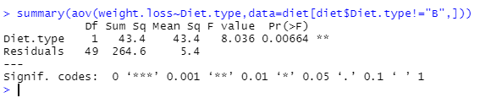
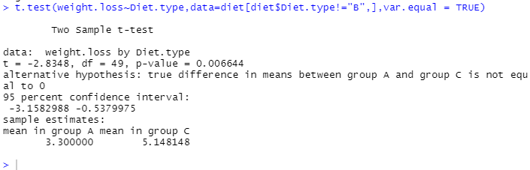

Slide 22
Inference
Here we use two sample T test for examining the difference in means for 2 population
The mean values significantly differ from sample A to sample C
Here sample A has a mean of 3.300000 and sample C has a mean of 5.148148

Slide 23
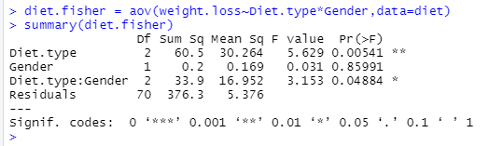
Two way Anova
The two way anova is the extension of one way anova that examines the influence of two different categorical independent variable on one continuous dependent variable
This test is very much efficient to interpret the result than one way anova

Slide 24
Result
Here in our project we use two way anova to reduce the occurrence of errors to certain extent
When we add one more independent variable, it will reduce the residual values to a certain extent
Hence by using two way we can reduce the variations that are caused by the independent variable

Slide 25

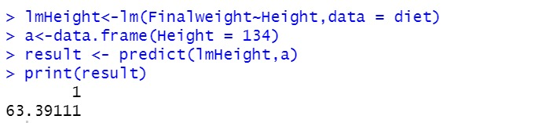
Linear regression

Slide 26
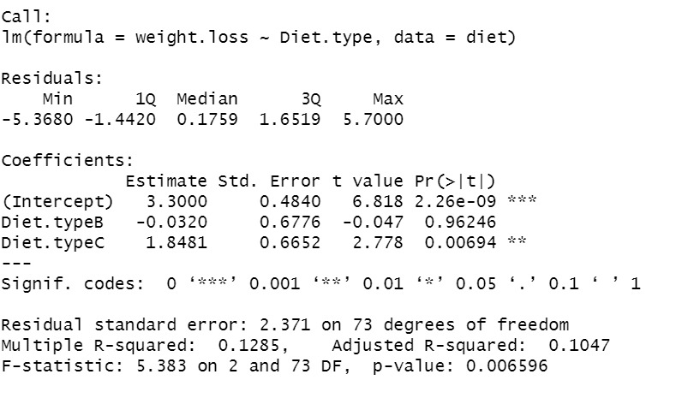
Inference
From this , the final weight of a person after the diet is mainly dependent on the height of a person.
By using diet C one can able to reduce upto 3kg.
By analysing the previous data, we can able to predict the weight by height.
When the person height is134cm,by using linear regression we predict the weight of the person is 63.39kg

Slide 27

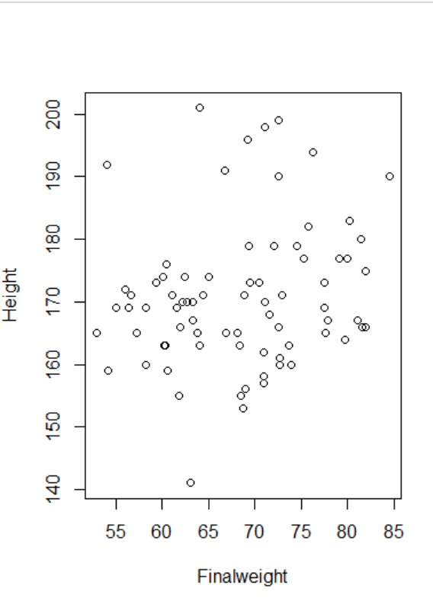
Scatter plot

Slide 28
Inference
Here the interpretation of the linear regression is visualized by the scatter plot .
The People who are practicing diet having weight ranges between 55-80 mostly lies on the height range160 to 175.

Slide 29
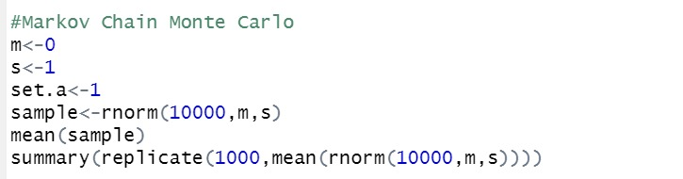
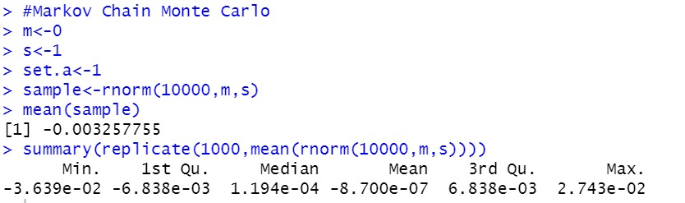
Markov Chain Monte Carlo

Slide 30
Inference
In statistics, Markov chain Monte Carlo (MCMC) methods comprise a class of algorithms for sampling from a probability distribution.
By constructing a Markov chain that has the desired distribution as its equilibrium distribution, one can obtain a sample of the desired distribution by recording states from the chain.
From this we can interpret that one can reduce weight of 1.19 kg in each diet type.

Slide 31
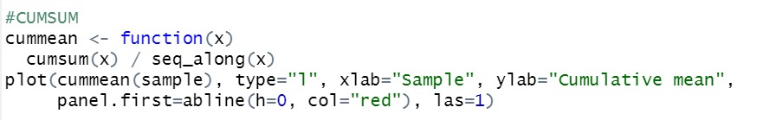
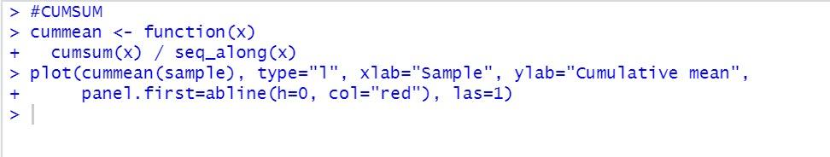
Cumsum

Slide 32
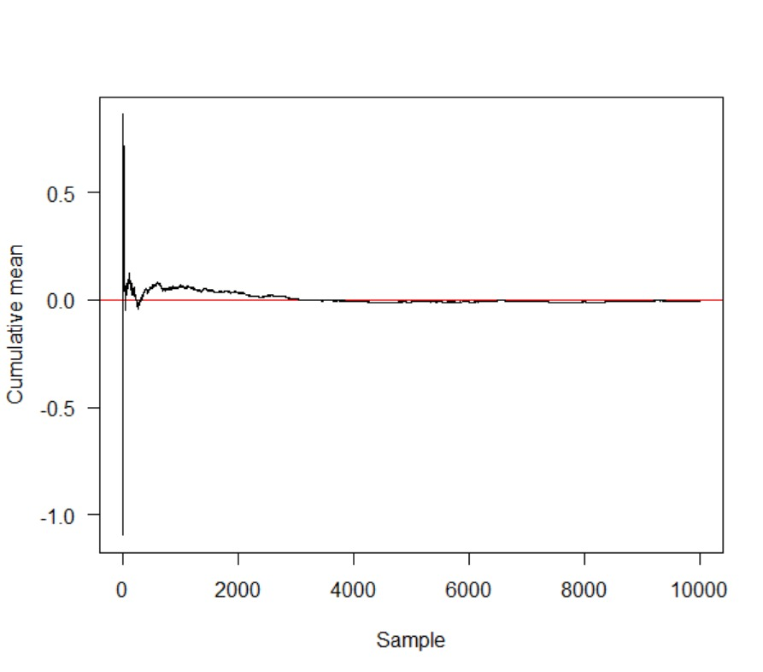
Inference
If Upward or downward trends develops the process mean has shifted and the process may be affected by special causes.
From this chart we can interpret in between 0 and 2000 the process will be affected from special causes

Slide 33
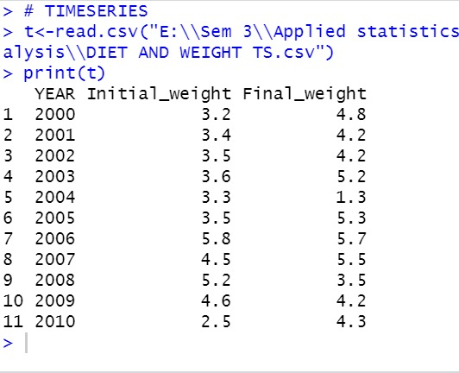
Time series

Slide 34
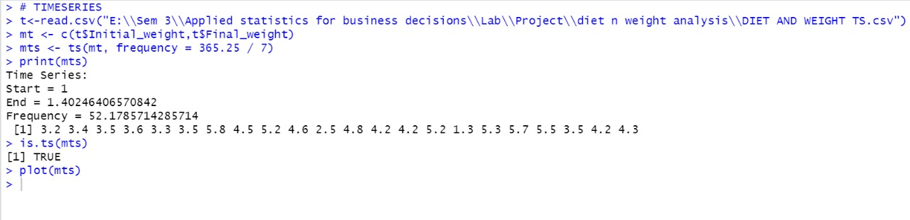
Time series Analysis

Slide 35
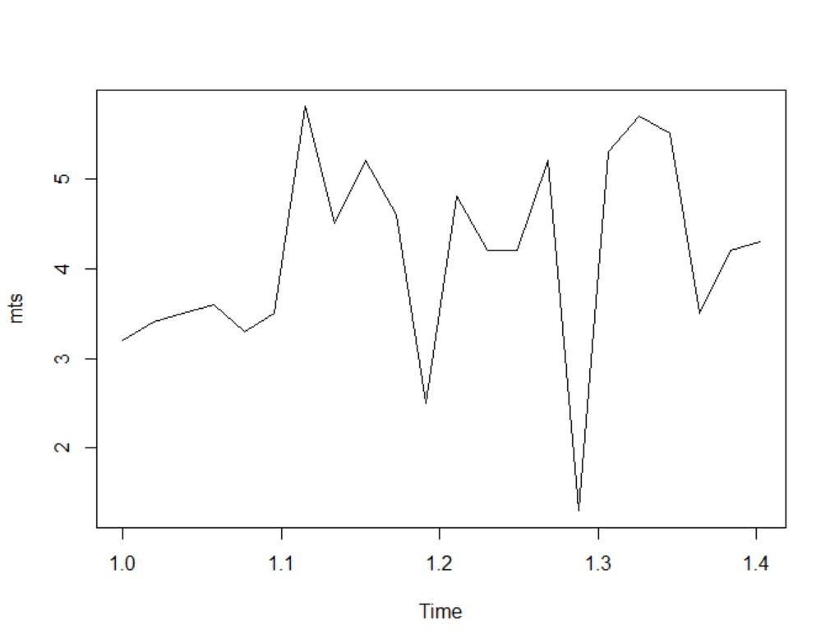
Graph

Slide 36

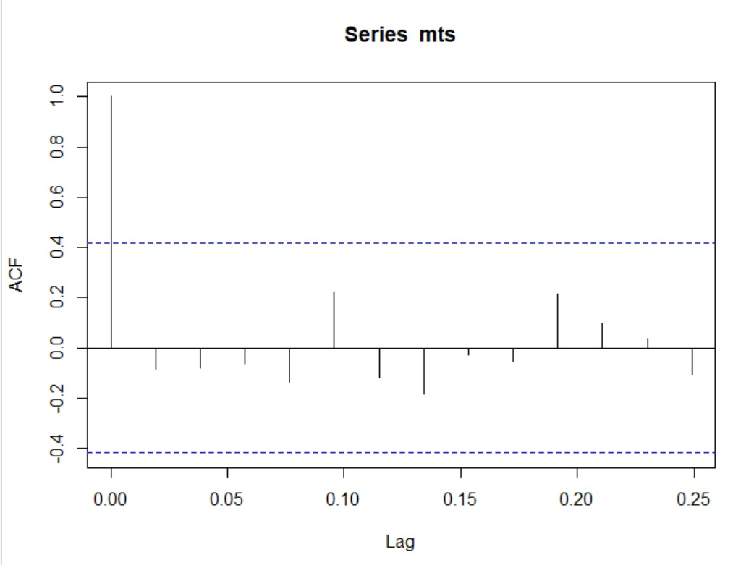
Auto correlation

Slide 37
Inference
An autocorrelation plot is designed to show whether the elements of a time series are positively correlated, negatively correlated, or independent of each other.
From this auto correlated plot ,we see that some of the values are positively correlated some are negatively correlated

Slide 38
Inference..
Therefore this auto correlation analysis suggests that some diet type may give positive results but there must be some negative outcomes also
Here in this graph it shows that diet type C has more positive values , So the diet type C is more effective and it is the preferable diet type.

Slide 39

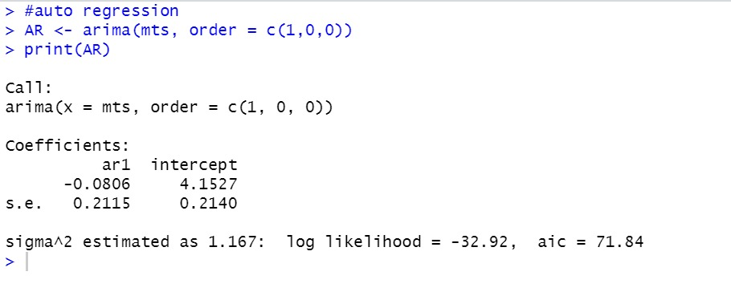
AUTO REGRESSION

Slide 40
INFERENCE
An autoregressive (AR) model predicts future behavior based on past behavior.
It’s used for forecasting when there is some correlation between values in a time series and the values that precede and succeed them.
From this we can interpret that type C shows gradual degradation over the years . From this we can infer the Diet type C is more effective for weight loss.

Slide 41
Thank you

